Slide 1

On Demand - HomeServices

Slide 2
KIET GROUP OF INSTITUTIONS
Guided By:
Dr. AMIT KUMAR GUPTA
Presented By: (GB2)
MOHD BILAL
ADITYA AWASTHI MAYANK SHARMA

Slide 3
ABSTRACT
This Online Home Services project deals with an online system designed for booking serviceman(electrician, carpenter, plumber, painter etc) as per the requirements of the customers at their convenience.
This software helps user to find serviceman profile and contact them or either click on book now button , after clicking on book now button , serviceperson will immediately contact to user.

Slide 4

Why do we need this project?
One of the main benefits is that you can save money. Taking multiple required services from a single Online home service provider means that one can save money as bundles are always the best. It is a very easy way of getting Online home services as compared to finding different providers for different services.
Another benefit of bundle services is the payment method. You can get everything rolled into one bill, there’s very less hassle.

Slide 5

ADMIN MODULES
Manage Servicemen's
Manage Users
Manage Bookings

Slide 6
SERVICEMEN MODULES
CREATE PROFILE
1
EDIT PROFILE
2
VIEW BOOKINGS
3

Slide 7
USER MODULES
SEARCH SERVICEMEN
VIEW SERVICEMEN PROFILE
BOOK SERVICEMEN

Slide 8
FRONTEND (LANGUAGE USED)
HTML(Hypertext Markup Language)
CSS(Cascading Style Sheet)
JAVASCRIPT
BOOTSTRAP(Framework of CSS and Javascript)

Slide 9
BACKEND
PHP(SERVER SIDE LANGUAGE)
MYSQL(DATABASE)

Slide 10
SOFTWARE USED
XAMPP(APACHE MYSQL PHP)
NOTEPAD++ / SUBLIME or ANY TEXT EDITOR
GOOGLE CHROME OR ANY BROWSER

Slide 11
USE CASE DIAGRAM
Use case diagram consists of use cases and actors and shows the interaction between them. The key points are:
The main purpose is to show the interaction between the use cases and the actor.
To represent the system requirement from user’s perspective.
The use cases are the functions that are to be performed in the module.
An actor could be the end-user of the system or an external system.

Slide 12
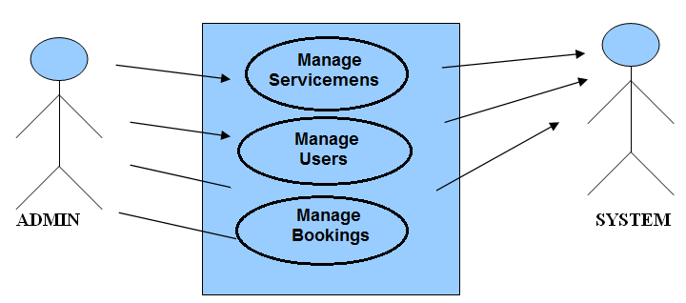
USE CASE - ADMIN

Slide 13
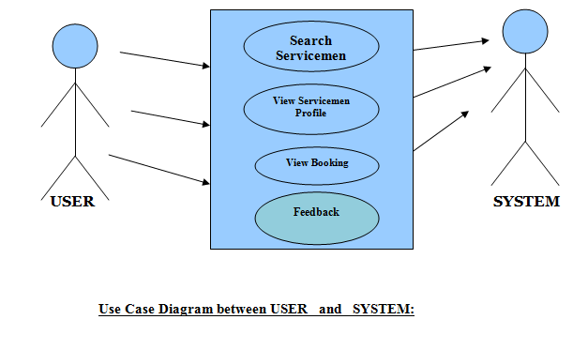
USE CASE - USER

Slide 14
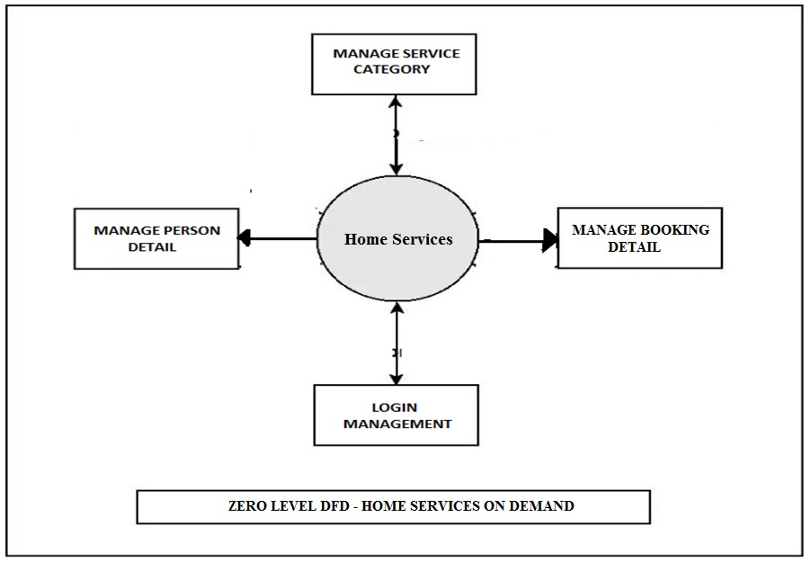
DFD(Data Flow Diagram)

Slide 15
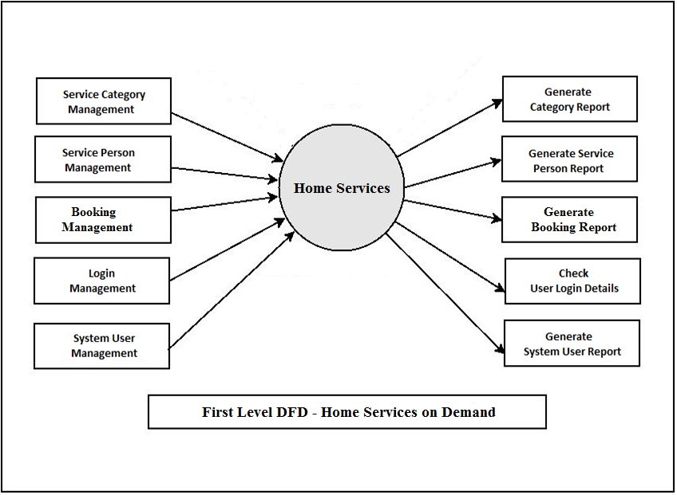
DFD(Data Flow Diagram)

Slide 16

ER DIAGRAM

Slide 17
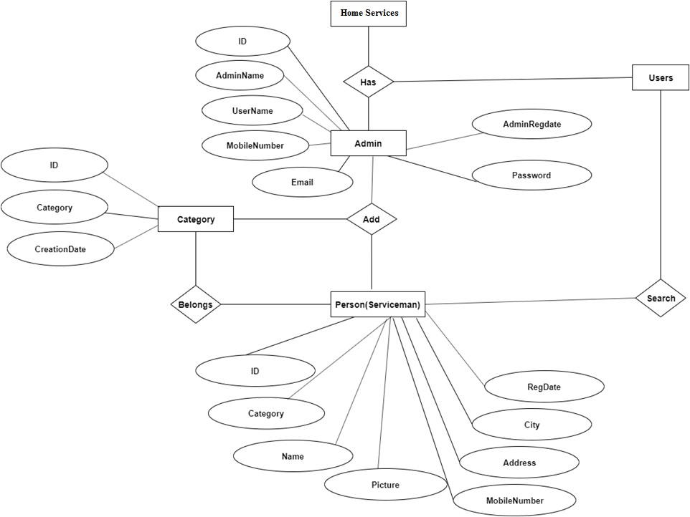

Slide 18
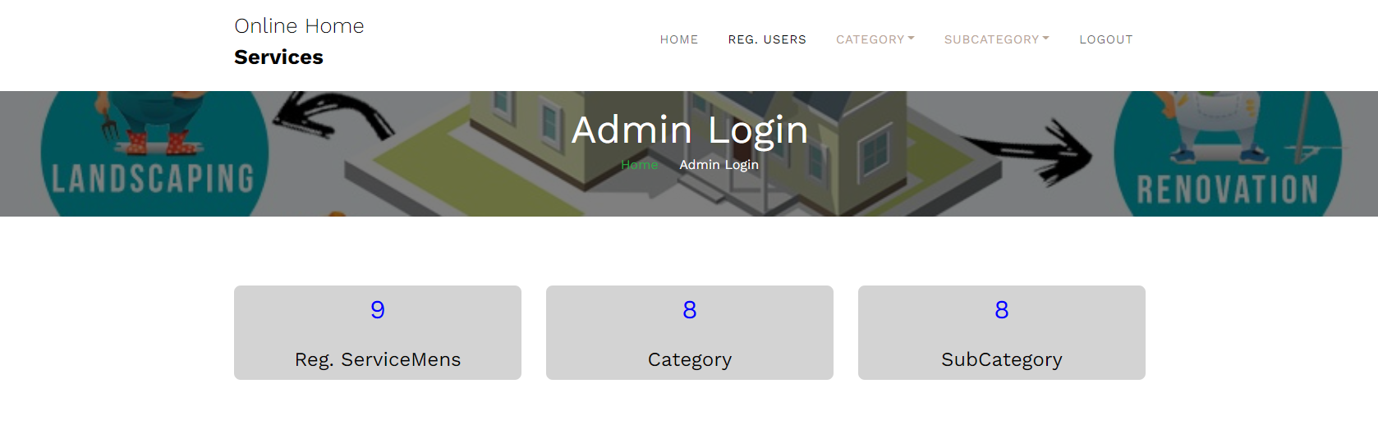
ADMIN LOGIN Page

Slide 19
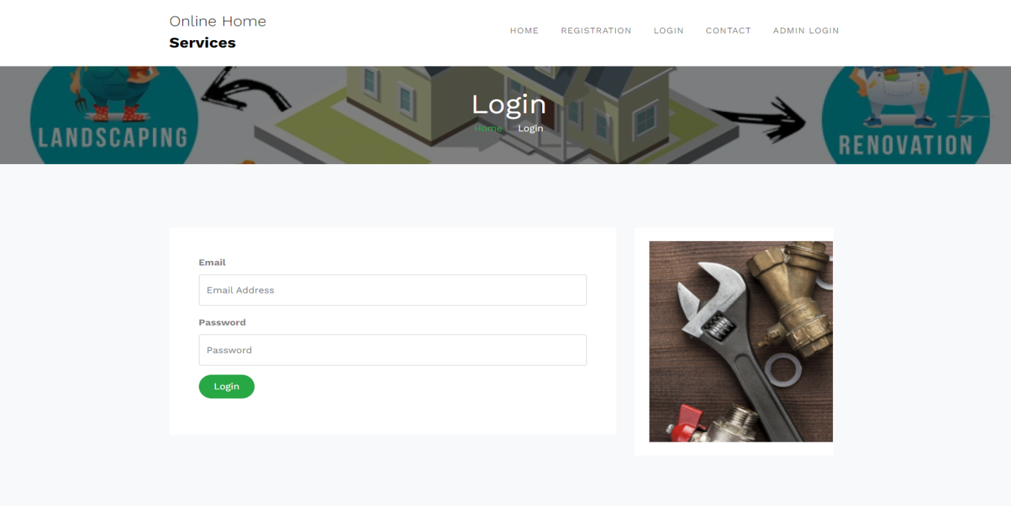
Login Page

Slide 20
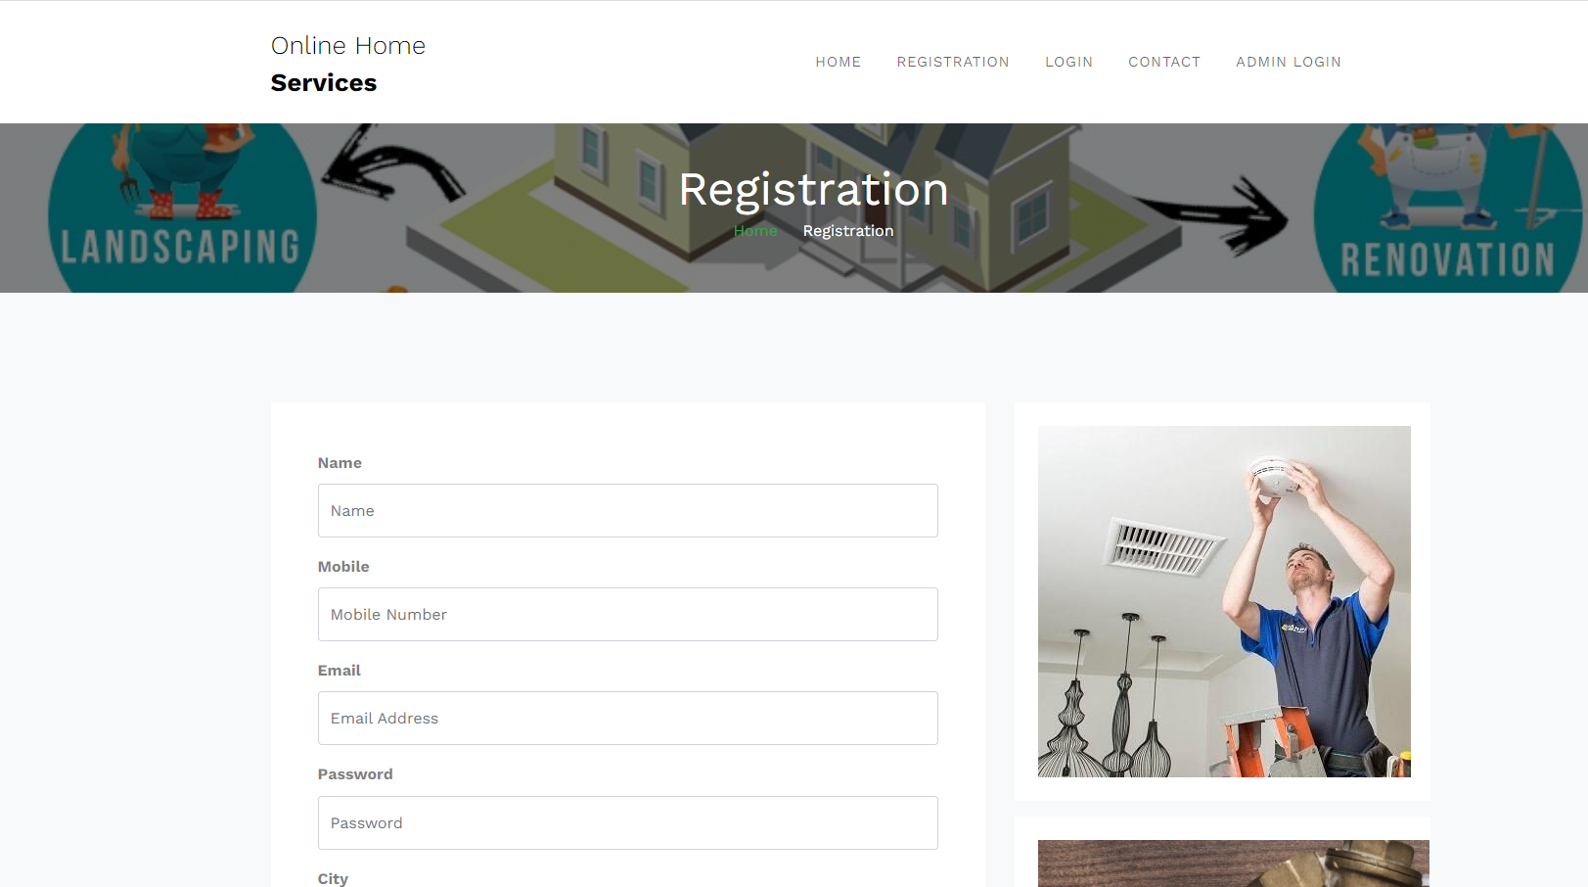
SIGNUP PAGE

Slide 21
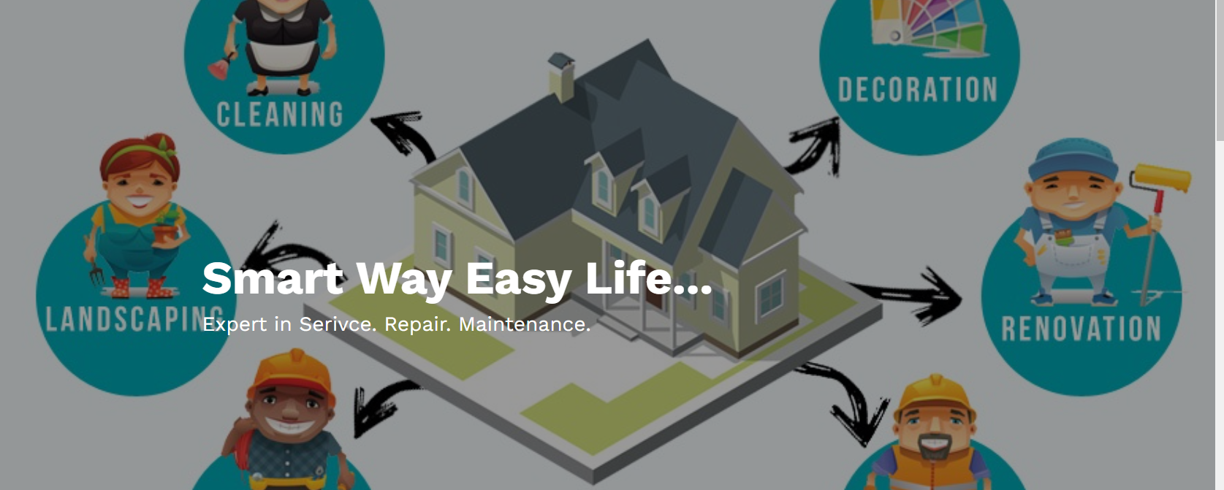
USER HOME PAGE

Slide 22
CONCLUSION & FUTURE SCOPE
FUTURE SCOPE
This web application involves almost all the features of the online services. The future implementation will be online help for the customers and chatting with website administrator.
CONCLUSION
The project entitled “Home services System” is developed using PHP as front end and MYSQL database in back end to computerize the process of online serviceman booking. This project covers only the basic features required.

Slide 23
BIBLIOGRAPHY
FOR PHP , HTML, CSS , JQUERY REFERENCES
http://www.w3schools.com/default.asp
http://www.javatpoint.com
REFERENCE BOOKS
Elisabeth Robson,” Head First HTML with CSS & XHTML ” .
Jon Duckett, “HTML and CSS”.

Slide 24
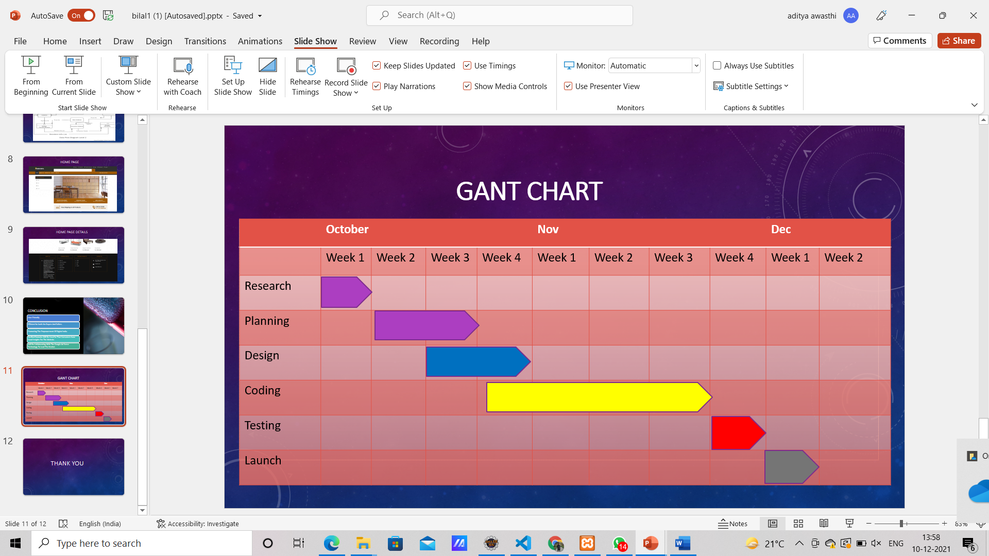

Slide 25
THANKYOU

